Slide 1
Natural Disaster Database
Kelsey Robertson

Slide 2
Database Description
This database was designed for Natural Disaster Coordination, providing a platform to manage and streamline disaster response efforts. It focuses on efficiently organizing critical information about affected locations, available resources, and specialized rescue teams. By connecting these elements, the database enables disaster response organizations to coordinate efforts more effectively, minimize response times, and optimize the allocation of resources
Centralized Data Management: Combines multiple aspects of disaster response in one database for easy access and updates.
Enhanced Coordination: Links affected locations with available resources and specialized teams to optimize relief efforts.
Data-Driven Decisions: Provides actionable insights for disaster management organizations and stakeholders.

Slide 3
Problem To Be Solved
This database addresses the challenges of managing disaster response efforts by organizing information about affected locations, available resources, and specialized rescue teams. It helps disaster response organizations identify regional needs, allocate resources efficiently, and deploy teams with the appropriate specializations. Additionally, it supports real-time communication and tracks the status of ongoing missions, allowing for clear coordination and efficient mission advancement.

Slide 4


Types of Disasters
Earthquakes
Hurricanes
Volcano Eruptions
Droughts
Tsunamis
Floods
Avalanches
Wildfires
Tornadoes

Slide 5
Key Features: Tables
Affected Locations
Available Resources
Teams
Deployments
Communication Logs
Stores information about specialized teams (e.g., medical, engineering, rescue)
Captures their size, expertise, contact details, and deployment status
Tracks disaster-stricken areas, including geographical details, disaster types, severity, and population affected
Captures required actions like evacuation or medical assistance
Maintains an inventory of essential supplies and equipment
Tracks resource status (e.g., available, in use, or depleted) and last updated dates
Links teams and resources to affected locations
Tracks mission objectives, status, and duration for monitoring progress
Documents communications between teams and command centers
Tracks methods like radio, email, or other forms of contact for transparency

Slide 6
How This Database Works
Data Integration: Real-time updates ensure accurate tracking of disasters, resources, and deployments
Cross-Table Relationships:
Example: Deployments link resources, teams, and affected areas to ensure cohesive operations
Scalable Design: Supports adding new disasters, regions, resources, or teams as needed

Slide 7
Benefits from Creation of Database
Improved Response Time: Quick access to critical information enhances disaster response efficiency
Resource Optimization: Ensures the right resources reach the right locations based on specific needs
Accountability: Logs and deployment tracking provide transparency and accountability for disaster relief efforts

Slide 8
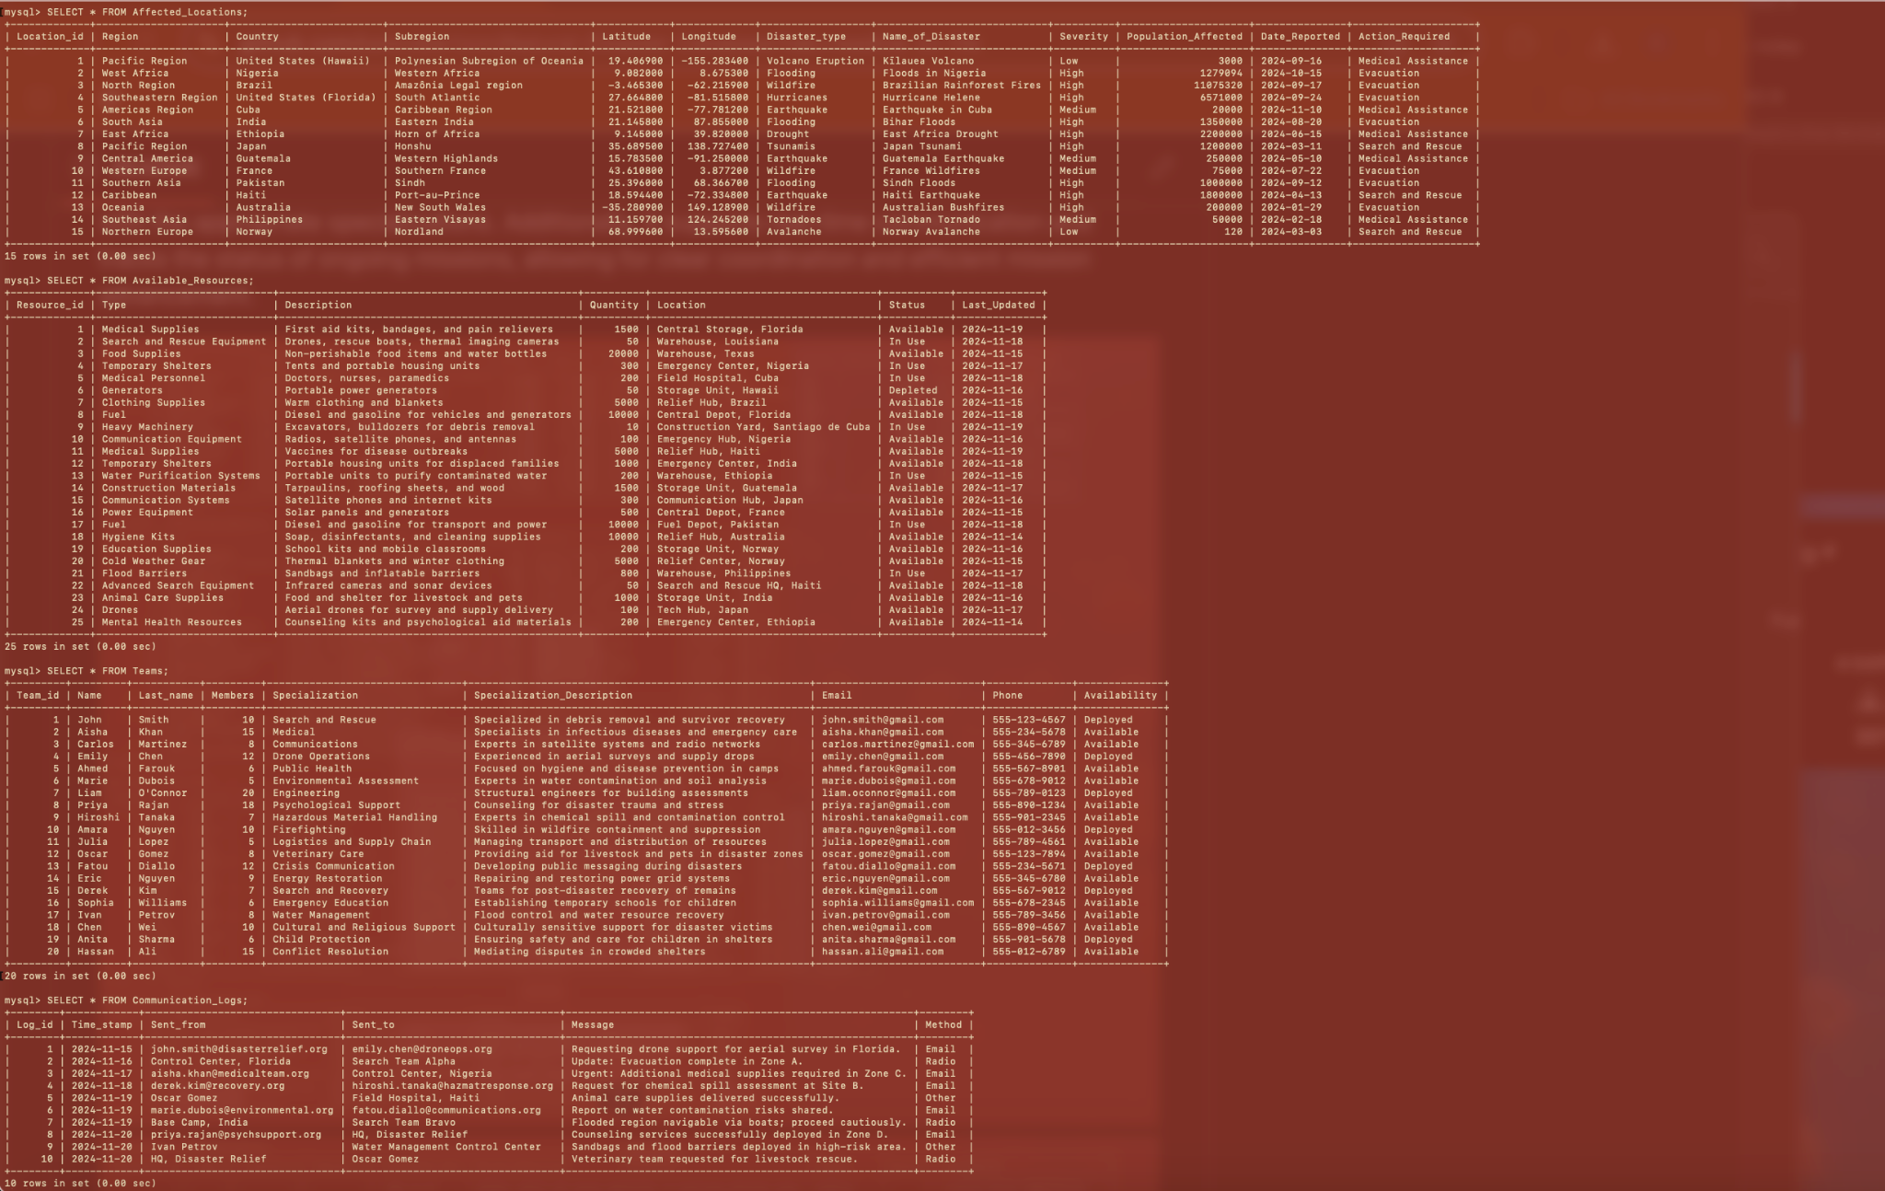

Slide 9
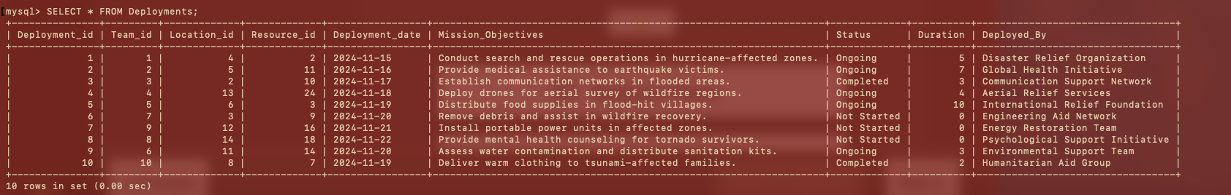

Slide 10
Github Link
https://github.com/kelsrobertson/Natural-Disaster-Database

